Slide 1
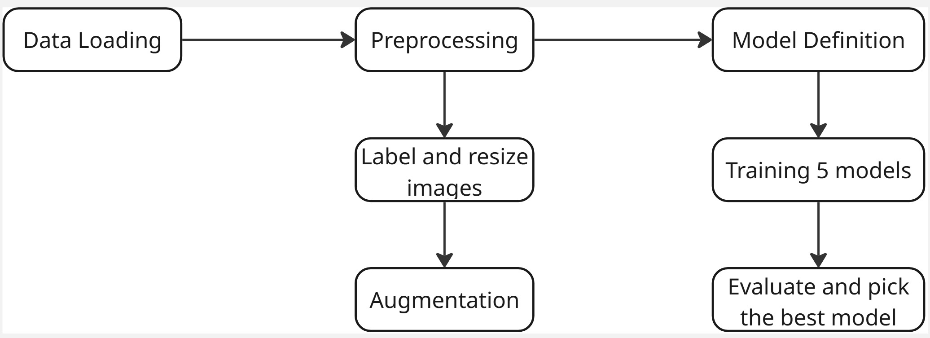
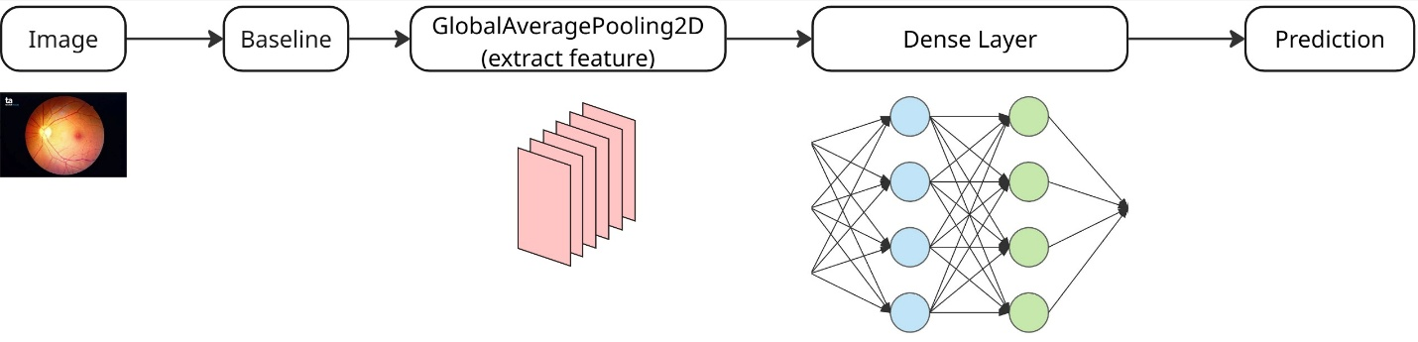
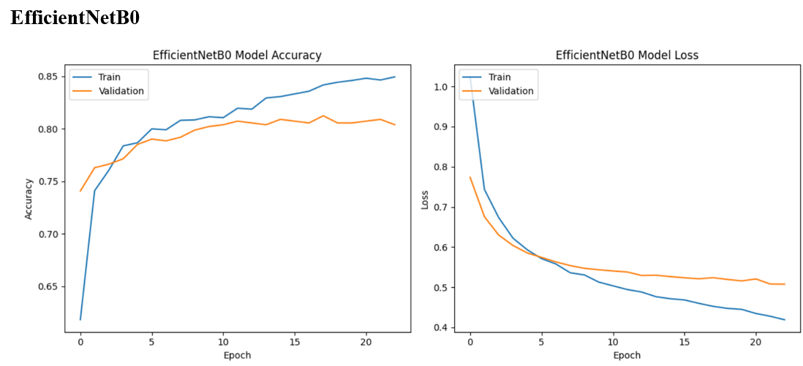
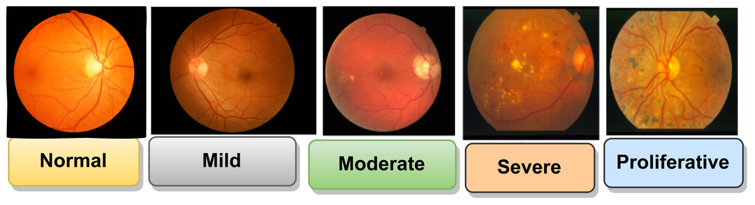
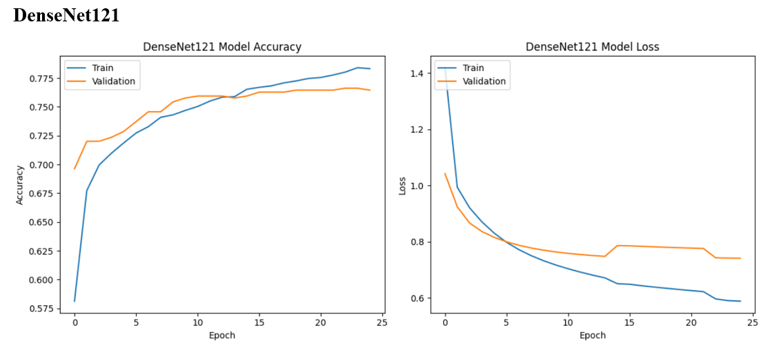
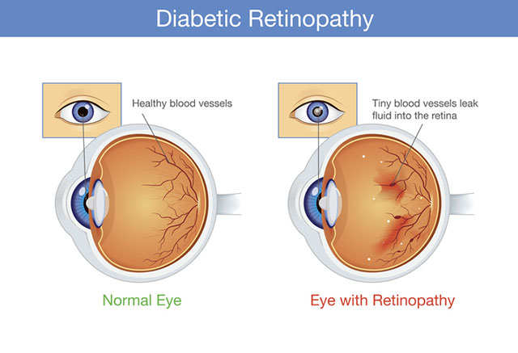
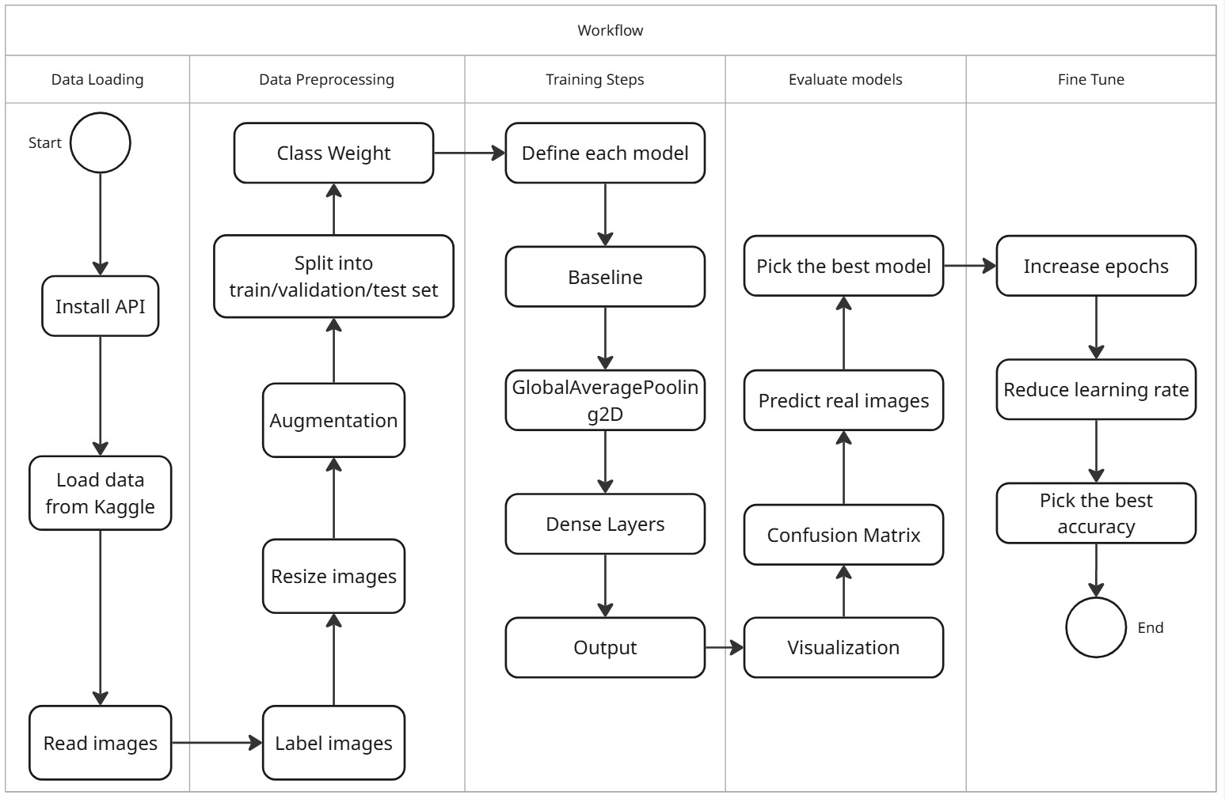
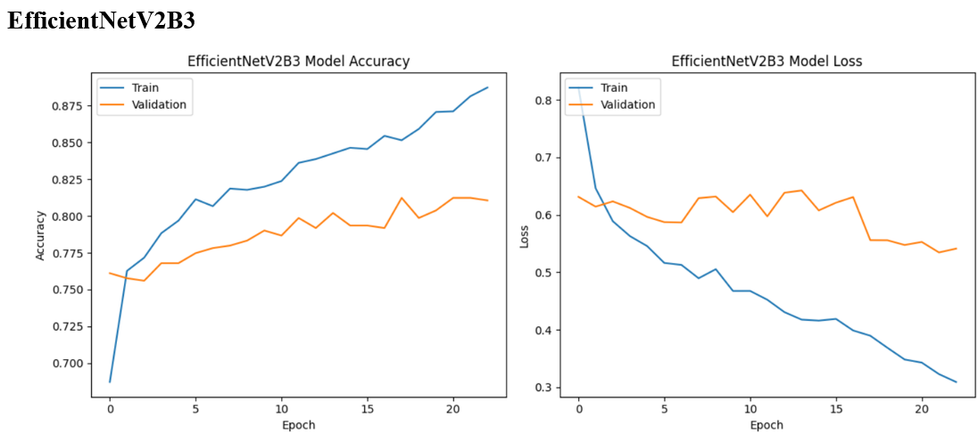
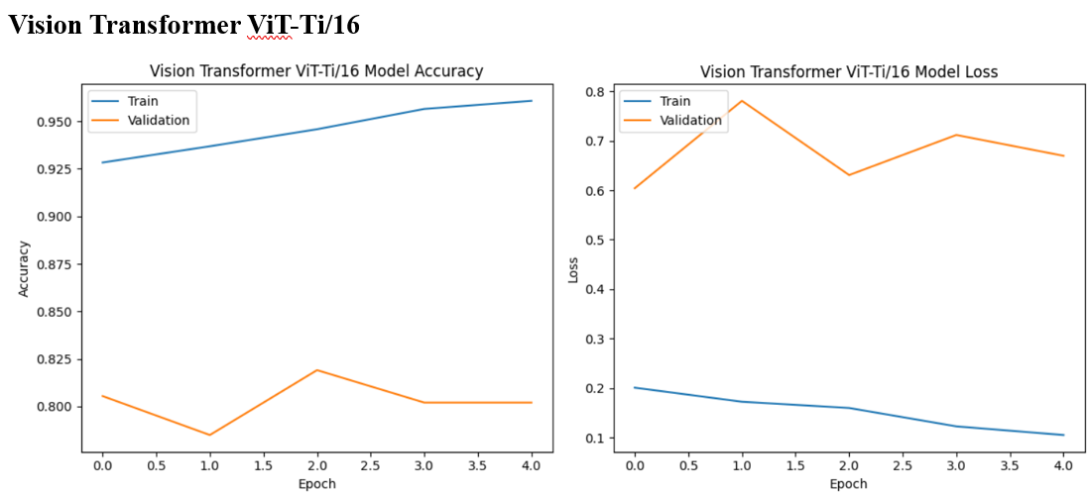
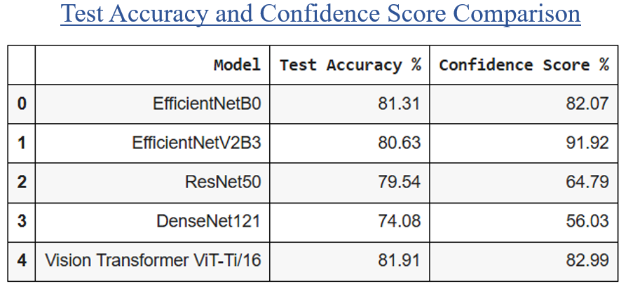
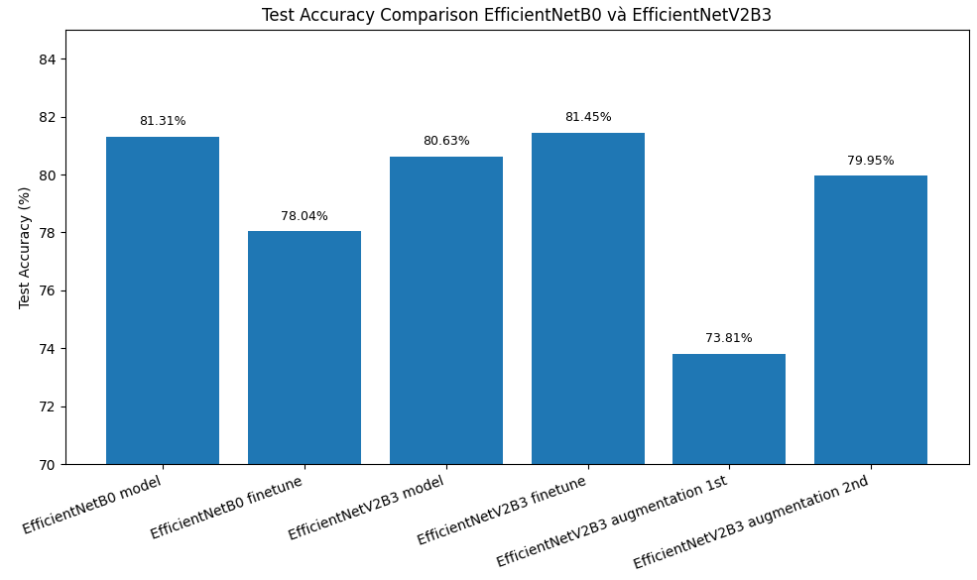
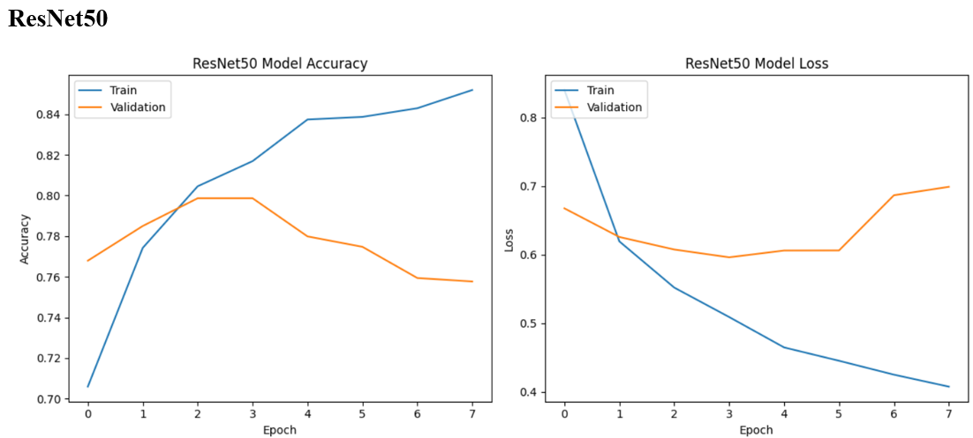
AI-powered classification of the diabetic retinopathy severity
Author: Thanh Thao Nguyen
Instructor: Himanshu Patel – Saskatchewan Polytechnic
Introduction
Project Diagram
Model Architecture
Scope of future work
This project investigates the use of EfficientNetV2B3, a state-of-the-art convolutional neural network architecture, for enhancing diabetic retinopathy severity classification accuracy in supporting the detection and treatment of diabetic retinopathy
Add your information, graphs and images to this section.
Expand the Dataset for Greater Diversity
The current dataset, while effective for experimentation, could be expanded to include more images of other diseases, such as Cataract and Glaucoma.
Deploy the model on a website
Building an interactive interface (e.g., using Streamlit), increasing productivity in classifying disease and early treatment.
Integrate into the telemedicine system
In the countryside, the patient can take photographs of their retina at a facility near their home.
AI can help to classify it.
Project Objective
• Implement EfficientNetV2B3 to classify diabetic retinopathy from retinal imagery with high accuracy.
• Optimize input data through preprocessing and augmentation.
• Compare EfficientNetV2B3 with EfficientNetB0, ResNet50, DenseNet121, and Vision Transformer ViT-Ti/16 under controlled conditions.
• Evaluate performance using the Accuracy of the Confusion Matrix.
• Generate reliable, generalizable classification results for practical use
Project Workflow
.
Conclusion
This project aims to develop a deep learning model EfficientNetV2B3 using for Diabetic Retinopathy classification via retinal high-resolution images.
The steps, such as data preprocessing, model training, and evaluation, are implemented to create accurate and efficient classification.
The expected outcome is to reduce classification time, patients can have good treatment, and improve their life quality.

